Slide 1
Interactive Music Player
Project creators :
GURINDER SINGH(2210990337)
GURKIRAT SINGH(2210990339)
GYANARANJAN BISWAL(2210990354)

Slide 2

Introduction
Welcome to “Music Player," a unique and interactive music experience crafted with the fusion of HTML, CSS, and JavaScript. In the world of code and creativity, we've harmonized these languages to bring you a music player that goes beyond the ordinary.

Slide 3
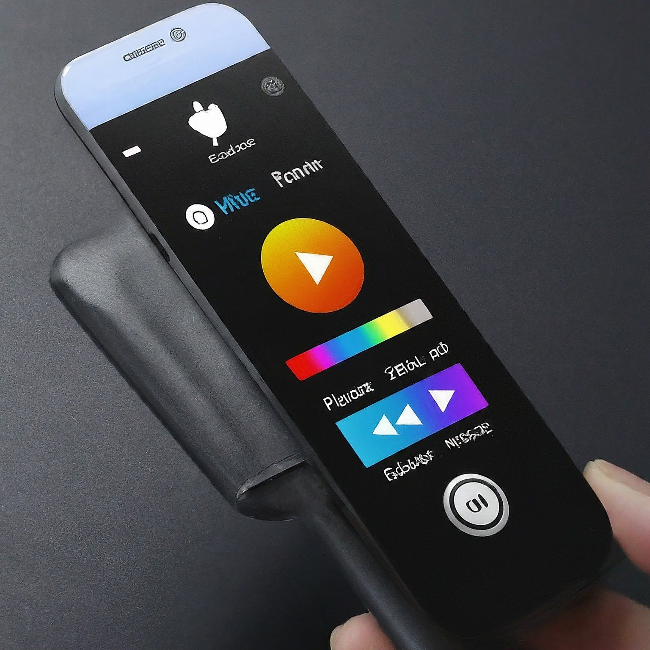

HTML Structure
•HTML defines the structure of the music player.
•We use various HTML elements for controls, progress bar, and display.
Speaker Notes
HTML provides the foundation for our music player. It defines the layout of the elements, including the audio element that holds the music file, the control buttons for play, pause, and volume, and the progress bar that shows the playback position.

Slide 4
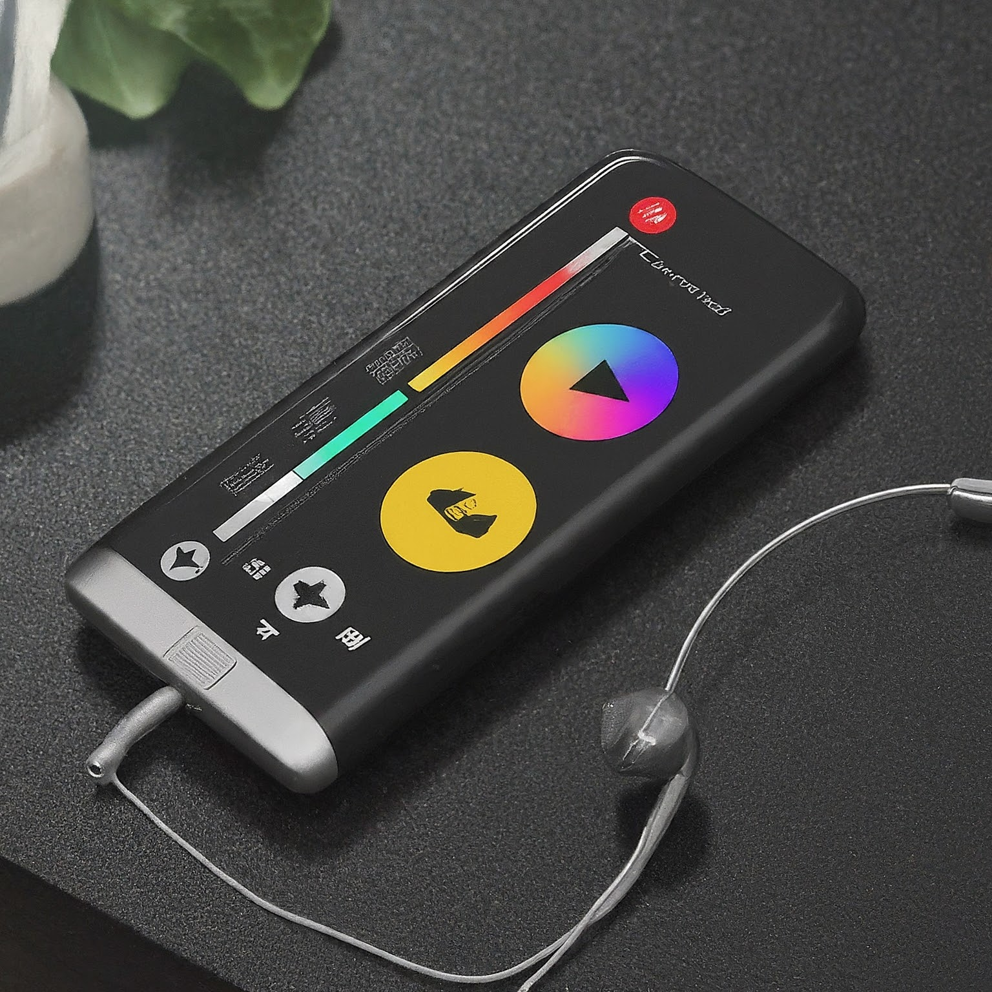
CSS STYLING
•CSS styles the visual appearance of the music player.
•We use CSS to style the buttons, progress bar, and overall layout.
•We can customize the look and feel of the player using CSS.
Speaker Notes
CSS brings our music player to life visually. We use CSS to style the buttons, progress bar, and the overall layout. We can customize the colors, fonts, and even create animations using CSS to enhance the user experience.

Slide 5
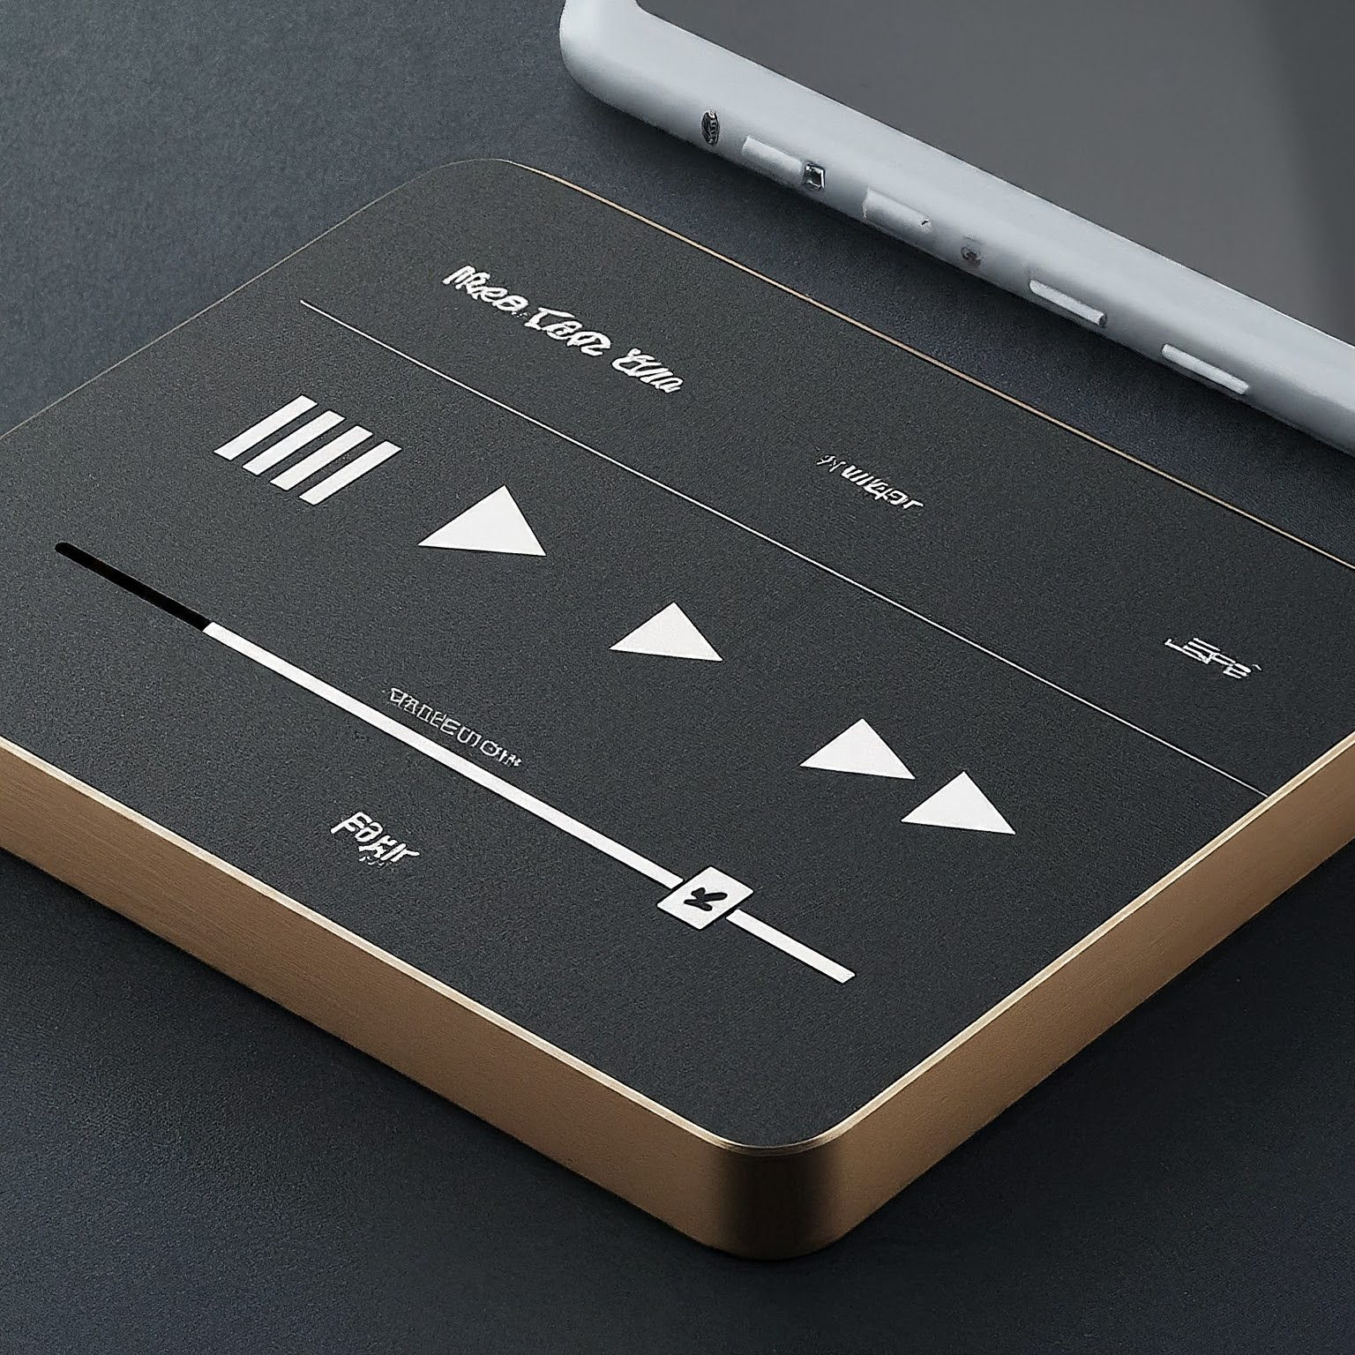
JAVASCRIPT Functionality
•JavaScript adds interactivity to the music player.
• We use JavaScript to control playback (play, pause, seek), update the progress bar, and handle user interactions.
• JavaScript allows us to implement features like volume control and playlist management.
Speaker Notes
JavaScript is the engine that drives the functionality of our music player. We use JavaScript to control the playback of the audio file, update the progress bar as the song plays, and handle user interactions with the control buttons. Additionally, JavaScript can be used for more advanced features like volume control and playlist management.

Slide 6

Conclusion
•We successfully built a music player using HTML, JS, and CSS.
• This project demonstrates the power of combining these technologies.
• We can expand on this project to include more features.
Speaker Notes
In conclusion, we've built a functional music player using HTML, JavaScript, and CSS. This project showcases the power of combining these web development technologies to create interactive applications. We can further enhance this project by adding functionalities like playlists, volume control, and seeking within the song.

Slide 7
Thanks!

